Slide 1
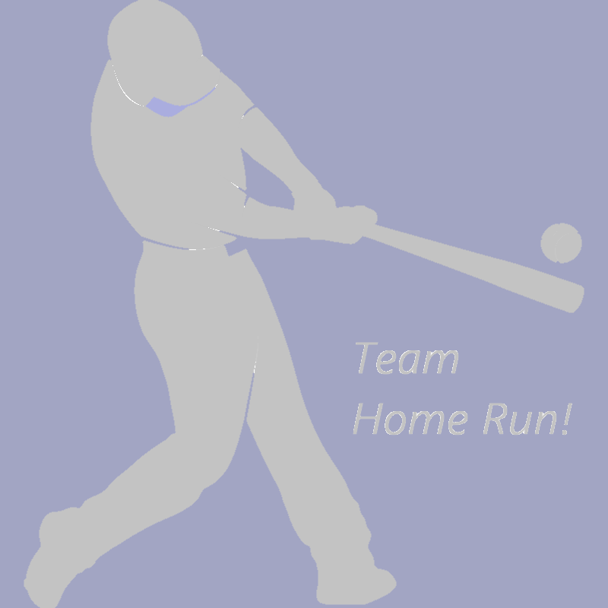
Home Credit Default Risk Prediction Project Progress
Phase 3
April 20, 2019
Notes:
DONG:: Welcome to the Team Home Run progress report.

Slide 2
Previous Phases
Phase 0
Planning
Phase 1:
Team processes
EDA
Feature engineering
Baseline model
Phase 2:
More feature engineering
More algorithms
Notes:
CHRIS: In previous phases we completed most of the standard phases of a data science project.

Slide 3
Phase 3 Accomplishments
Algorithms tested
Neural networks
Support vector machines
More feature engineering
Inspired by Team 1 features
Posted competitive Kaggle score
Used lightweight gradient boosting model (LGBM)
Notes:
DONG: In our final phase we tested neural networks and support vector machines, engineered a few more features, and posted a competitive score to Kaggle.

Slide 4
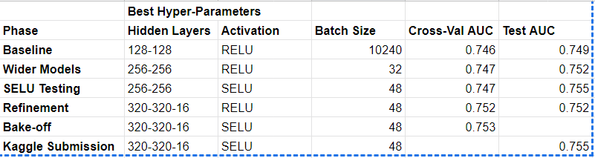
Completed: Neural Network
Best model
Hidden layer architecture = 320-320-16
Batch size = 48
Hidden layer activation = SELU
Dropout regularization = not helpful
Kaggle score - basically the same as LGBM with similar features
Notes:
CHRIS: In our neural network experimentation, we tested a variety of hidden layer architectures, activation functions, batch sizes, and regularization fractions. Our best model had hidden layers of 320, 320, and 16 nodes, and used scaled exponential linear unit activation.

Slide 5
Completed: Support Vector Machine
Slow
> 60 hours for hyperparameter optimization
Poor results
Best Validation AUC = 0.637
Not scalable
Non-linear support vector classifier is not scalable to large datasets
Notes:
DONG: Our SVM experiments yielded poor results, indicating that the SVM algorithm is unsuitable for our problem.

Slide 6
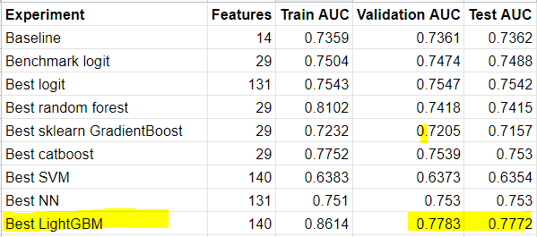
Completed: Classification Model Testing
LightGBM has best scores
Uses phase 3 additional features + all previous
Notes:
CHRIS: Our comparison of classification models shows that Lightweight Gradient Boosting achieves the best score. Neural networks have had a lot of hype recently due to their successes in language processing, image recognition, and reinforcement learning, but they do not seem to have any advantage over gradient boosting with tabular data such as ours.

Slide 7
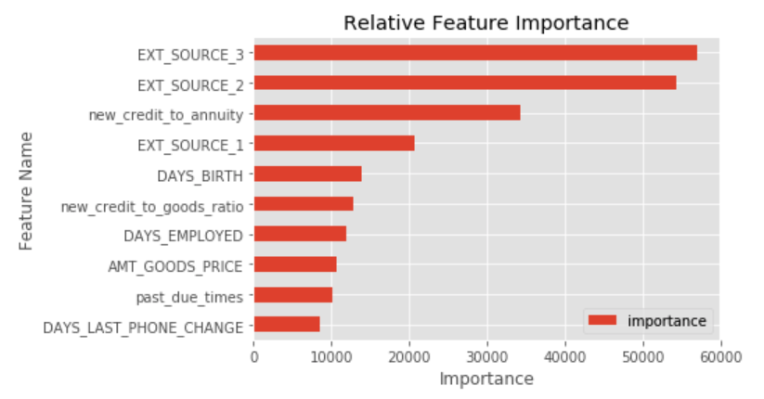
Feature Importance
Notes:
DONG: Three of the features engineered in phase 3 made the top 10 list, and helped increase our AUC score.

Slide 8
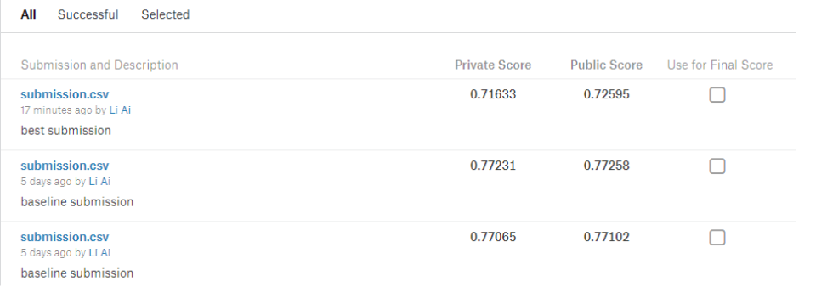
Best Result Posted to Kaggle
Notes:
CHRIS: Our final private score of 0.772 was close to the average for the Kaggle competition, and would have given us a ranking of 4419 out of 7199 entrants.

Slide 9
Recommendations for Future Work
New feature types
Trend features, e.g.
Payment history improving vs. declining
Credit score improving vs. declining
Clustered features, e.g.
Patterns of submitted document types
Patterns of payment history
Cloud collaboration environment
Resources
Isolated individuals limited to laptops vs. multi-GPU rigs on-demand in cloud
Organization/Information flow
Collating info from laptops vs. MLFlow for structuring experiments and logging results
Notes:
CHRIS: To build on our success, we recommend the engineering of new features, such as trend analysis and clustered features, and the use of a cloud collaboration environment such as MLFlow on Databricks in order to reduce the friction associated with individual testing on laptops. Thank you for your attention.

